Slide 1
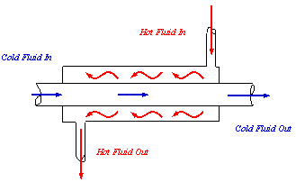
Heat Exchanger Design Project Brandon Douglas, Isaac Burns, Thomas Umscheid, & Robert Schnefke
Counter Flow Heat Exchanger using Water or Engine Oil as the Working Fluid
Flow Rates and Performance
Water Cold Flow Rate = 0.00175 kg/s
Quality with Steam Flow Rate of 0.00025 kg/s = 4.82%
Quality with Steam Flow Rate of 0.0005 kg/s = 53.39%
Quality with Steam Flow Rate of 0.001 kg/s = 77.68%
Engine Oil Cold Flow Rate = 0.002 kg/s
Quality with Steam Flow Rate of 0.00025 kg/s = 75.03%
Quality with Steam Flow Rate of 0.0005 kg/s = 88.50%
Quality with Steam Flow Rate of 0.001 kg/s = 95.24%
Cold Working Fluid Temperatures for both Water and Engine Oil
Inlet Temperature for Both = 300 K
Outlet Temperature for Water = 371.84 K
Outlet Temperature for Engine Oil = 338.51 K
Uncertainty for Heat Duty of Water Counter Flow Heat Exchanger
± 7.53 %

