Slide 1
Senior Design Project:
KSU Wind Turbine Design Review 4
John Annan
Tanner Lott
Shane Smith
Hayden Thull
Thomas Umscheid

Slide 2
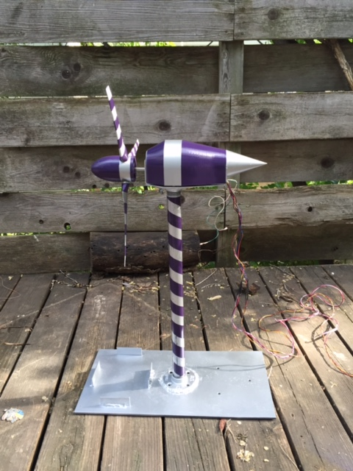
Overview
Goals for the Semester
Structure Rebuild
Gearbox
Wind Tunnel Testing
Competition Results
Budget
Lessons Learned
Legacy

Slide 3
Goals for the Semester
This project’s main goal is to design and build an optimal wind turbine for the Wind Turbine Design Team. By working with the electrical engineering students, we will ensure that we meet all of their demands for the design. We have been focusing on the blade shape, angle, number of blades, and materials. We have used a variety of software to test designs, and to find the desired data for the competition. Finally, while doing all of this research and testing we will make sure we keep detailed records for future design teams.

Slide 4
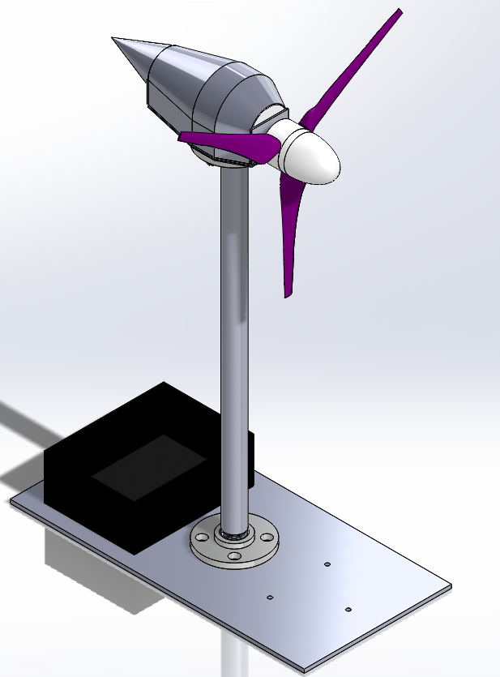
Structure Rebuild
New baseplate
Modified electrical box
Smaller shaft with flanges
Superior welds

Slide 5
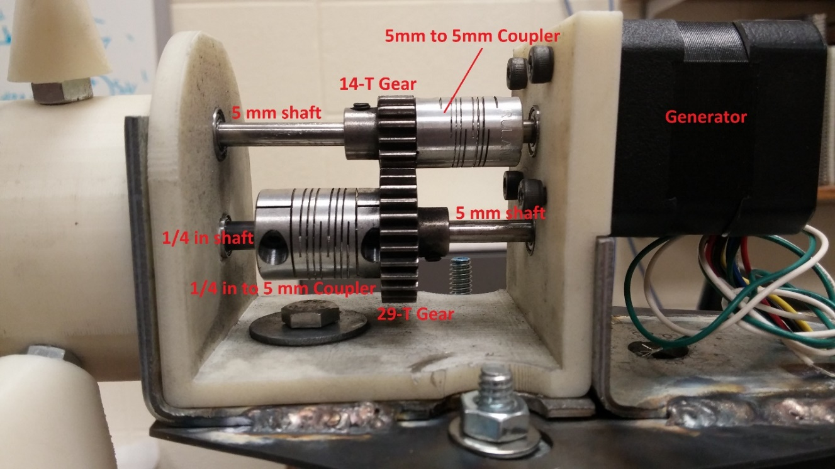
Gearbox
Decided to build our own
2.07 to 1 ratio
Gears mounted to 5mm shafts
Used ¼ to 5mm coupler from blades, 5mm to 5mm coupler from top gear to generator
Decided to change mounting bracket configuration to accommodate gearbox

Slide 6
Wind Tunnel Testing
Tested at the Wind Erosion Lab in town
During our testing we produced 9 watts
Electrical problem forced us to cut our test short
While we wanted more, we only got one conclusive test

Slide 7
Competition Results
First test had incorrect pitch so we didn’t obtain desirable results
Decided to use junior team design for competition
Tested for non-competition results and bearing came loose
  We believe assembling and reassembling the part caused plastic deformation
Based on calculations we believe we would have produced just over 7 watts

Slide 8
Budget

Slide 9
Lessons Learned
More efficient meetings
Early build times
Build to one standard of measurement (metric or SAE)
Purchase an organizer to store equipment and parts
Find a more effective wind tunnel for testing
Use prefabricated parts as often as possible
Some glues don’t mix well with ABS plastic

Slide 10
Legacy
Provide detailed, thorough continuity for future mechanical team
  Detailed design documents over software used
  Testing reports covering successes and failures
  Reports detailing evolution of turbine design
  Competition specifications

Slide 11
Conclusion
Goals for the Semester
Structure Rebuild
Gearbox
Wind Tunnel Testing
Competition Results
Budget
Lessons Learned
Legacy

Slide 12
?
Questions

